Slide 1
GICharm: A System Level Analysis Tool for Geomagnetic Disturbance Related Harmonics
Andres Ovalle, PhD
Engineer Scientist III
EPRI, Knoxville, TN
May 12th, 2022

Slide 2

Speaker
Andres Ovalle
Andres Ovalle is an Engineer/Scientist III with the Power System Studies team at the Electric Power Research Institute (EPRI). His current research activities focus on modeling of power systems, system protection in distribution and transmission, and impacts geomagnetic disturbance related harmonics on power systems. Mr. Ovalle joined EPRI in 2018. Prior to joining EPRI, Mr. Ovalle was with the French National Railways Company (SNCF) and the Grenoble Electrical Engineering Laboratory (G2E-lab) for approximately 2 years where he worked as a postdoctoral research engineer in the use of energy storage for the support of electrified railways. Mr. Ovalle received the B.S.E.E. degree from the Universidad de Los Andes, Bogota, Colombia, in 2011, the M.E.E. degree from the Universidad de Los Andes in 2013, and the Ph.D. in Electrical Engineering from the Université de Grenoble Alpes, Grenoble, France, in 2016.

Slide 3
Agenda
What is GIC and GIC related harmonics?
EPRI GICharm
Transformer level Analysis
System level Analysis
Test cases to explore
Quick demo
Notes:
First I’m going to talk about what is GIC and are GIC-ralted harmonics
Then I’m going to talk about GICHarm, the components of the tool and and overview of the routines behind the program,
Then I’m going to talk about a validation test that we have performed to compare against published experimental results
And finally, I’m going to briefly discuss a couple of additional test cases that users of the tool can explore when they test GICharm. It is worth mentioning at this point that the tool is publicly available at EPRI.com.
We encourage you to download and test it.

Slide 4
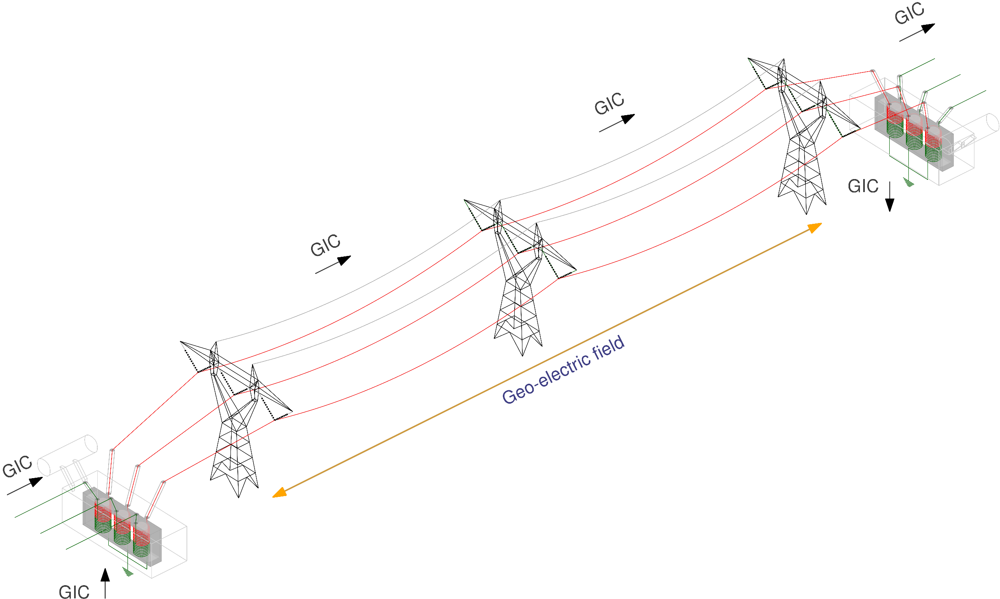
What is GIC?
Geomagnetic disturbance event
Quasi-DC currents induced on transmission lines (man-made long metallic infrastructures)
GIC flows can be computed using industry software
[1] EPRI, Geomagnetic disturbance vulnerability assessment and planning guide, 3002013590, 2018.
[2] NERC, GMD Monitoring, mitigation and next steps, literature review and summary of the April 2011 NERC GMD workshop, 2011.
[3] IEEE Guide for Establishing Power Transformer Capability while under Geomagnetic Disturbances," in IEEE Std C57.163-2015 , vol., no., pp.1-50, 26 Oct. 2015
Notes:
GIC stands for geomagnetically induced currents, and these are quasi-DC currents that get induced in long metallic infrastructures (like pipes or the conductors in our transmission lines). These occur when we have a geomagnetic disturbance event or GMD which is a physical phenomenon that occurs when charged particles coming from the sun, reach the Earth’s atmosphere and interact with the magnetic field and the atmospheric gases.
Typically, GIC flows in Power Systems can be computed using Industry software tools like PSS/E, PowerWorld or PSLF.

Slide 5
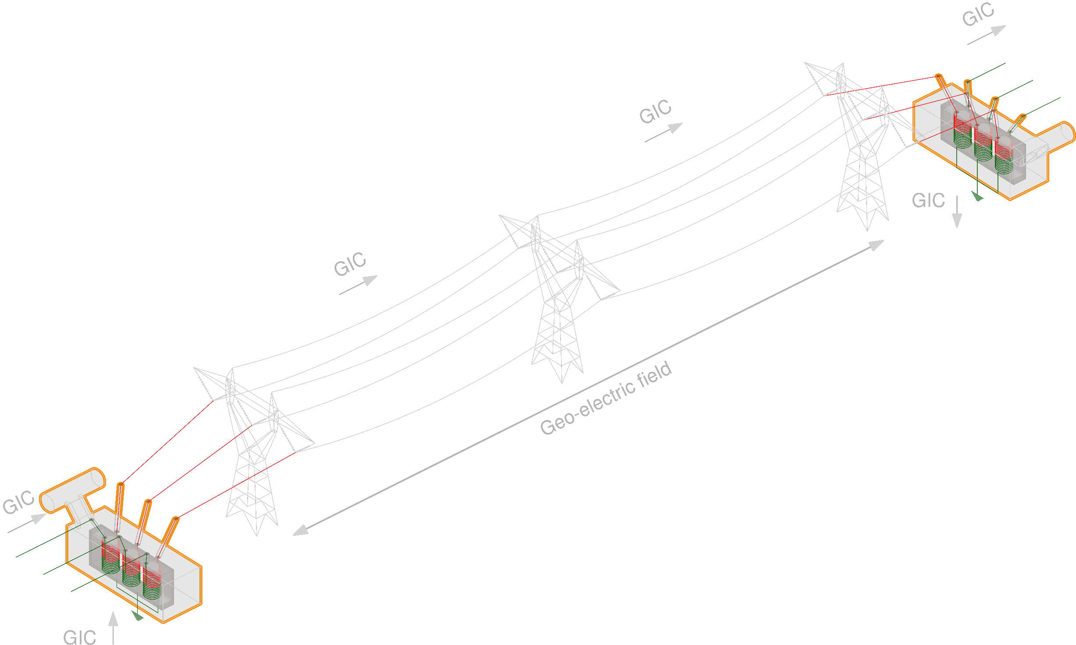
What is GIC?
Geomagnetic disturbance event
Quasi-DC currents induced on transmission lines (man-made long metallic infrastructures)
GIC flows can be computed using industry software
Transformer saturation
Saturation induced harmonics
Reactive Power loss
Impacts on protection equipment, resonance, etc.
[1] EPRI, Geomagnetic disturbance vulnerability assessment and planning guide, 3002013590, 2018.
[2] NERC, GMD Monitoring, mitigation and next steps, literature review and summary of the April 2011 NERC GMD workshop, 2011.
[3] IEEE Guide for Establishing Power Transformer Capability while under Geomagnetic Disturbances," in IEEE Std C57.163-2015 , vol., no., pp.1-50, 26 Oct. 2015
Notes:
When the GIC flows reach the ends of the transmission lines, they flow into the transformer terminals.
This, in turn, causes a quasi-DC component to appear in the transformer’s flux waveforms that pushes them to saturation. This saturation results in pulse-like waveforms in the excitation currents whose fundamental component is 90-degrees phase-shifted with respect to the voltage fundamental. This causes a reactive power loss and therefore a voltage drop.
Additionally, these pulses have several harmonic components other than the fundamental. These harmonics can cause problems with the protection systems and can also excite resonances across the system.

Slide 6
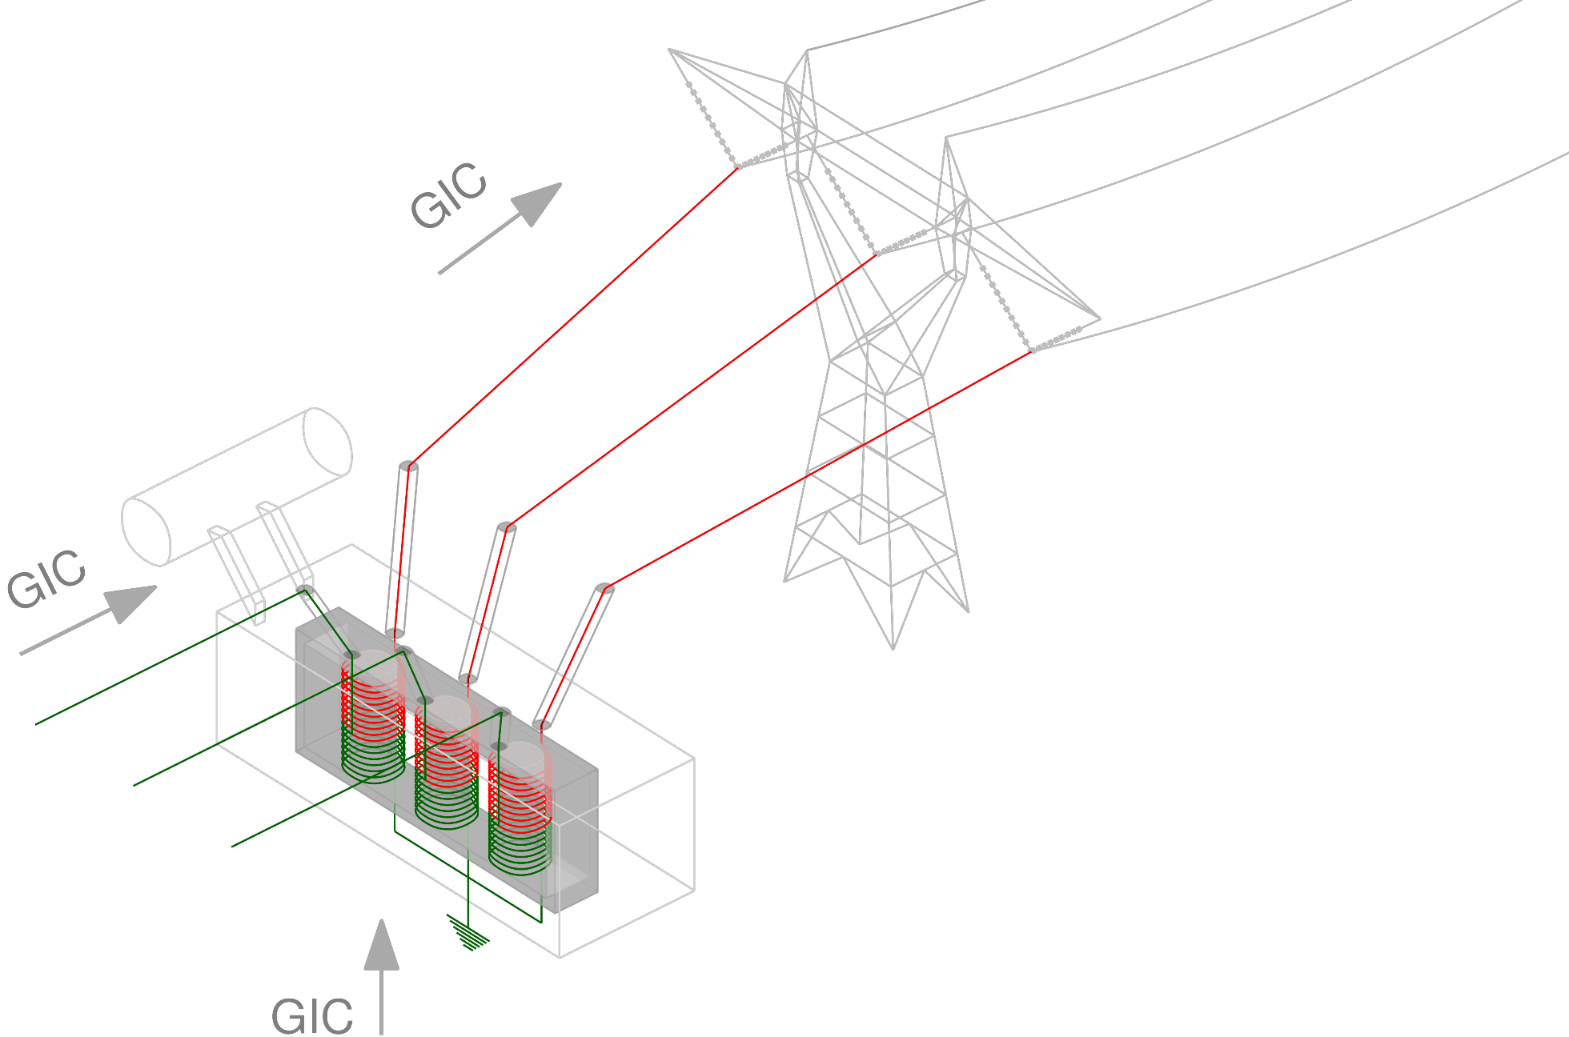
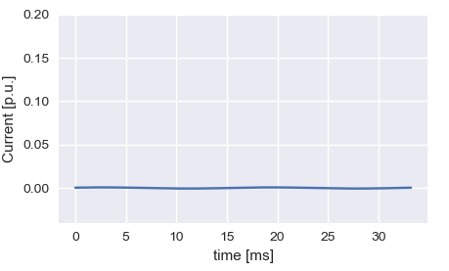
GIC Related Harmonics
Transformer core saturation
Excitation currents and reactive power losses
Excitation currents Normal operation
Notes:
Another dimension of the problem appears when we consider the actual construction of each transformer.
Typically, the excitation currents of the transformer under normal operating conditions are relatively low.
(next slide - >)

Slide 7
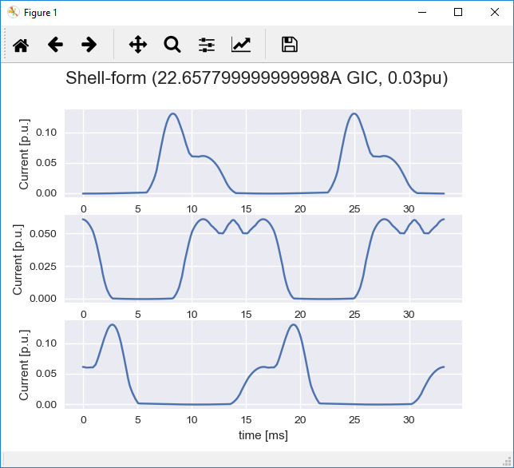
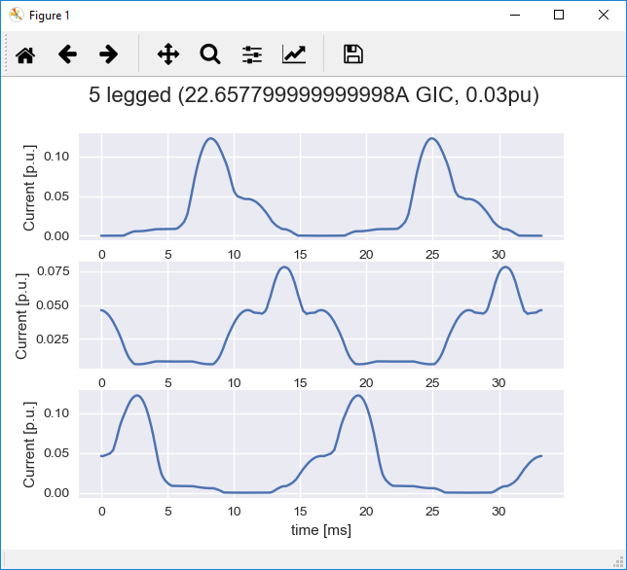
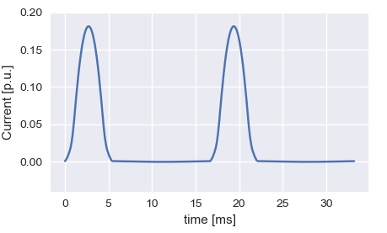
GIC Related Harmonics
Transformer core saturation
Excitation currents and reactive power losses
Excitation currents half-cycle saturation
Core-dependent
Notes:
When we have a bank of three single-phase transformers, and they saturate due to GIC, the excitation currents typically have these pulse-like waveforms with a 120-degree phase-shift for each phase.
When we have a three-phase core-form or shell-form transformer, the shape of the excitation waveforms changes drastically. The waveforms are different between phases and their harmonic content also changes if we compare with the bank case.
Here on the left we have some typical current waveforms for shell-form and 5-limb core-form transformers.

Slide 8
GIC Related Harmonics
Transformer saturation
Excitation currents and reactive power losses
Core topology dependence
How to handle hundreds of transformers in the bulk power system?
Lack of tools to assess the impact of GIC related harmonics in the bulk power system
Notes:
This is the motivation behind the development of GICharm,
How do we model several transformers across the entire power system getting affected by different GIC levels?
How do we assess the impact these saturated transformer would have when their harmonics flow across the system?
Will we have resonances being excited by these harmonics?
There is a lack of tools across the industry to tackle this research questions and GICharm is intended to fill that gap.

Slide 9
EPRI GICharm

Slide 10

EPRI GICharm
Software tool to assess the impact of GIC related harmonics
Most recent version available to the public in through www.epri.com (link below)
Extensive system modeling
Accurate representation of transformer saturation
Uses EPRI’s OpenDSS engine
Includes built-in converter from a commercial planning software
https://www.epri.com/research/products/000000003002018769
Notes:
As I mentioned before, GICharm is a tool to assess the impact of GIC related harmonics on the power system.
It is publicly available at EPRI.com through the link at the bottom of this slide.
The tool is capable of extensive system modelling. It was implemented to analyze the excitation currents of single transformer under saturation as well as to analyze effects of GICs on a fleet of transformers and the impact of related harmonics.
It was also designed to use the appropriate level of modeling detail for the transformer various magnetic circuits.
GICharm uses EPRI’s OpenDSS scripting language to define the system models and the OpenDSS engine to run the system harmonics analyses. IT also uses an internal solver to compute the excitation current waveforms for a transformer under GIC.
Additionally, to help users work with GICharm, the tool includes a built-in converter from PSS/E’s file format to GICharm/OpenDSS format.

Slide 11
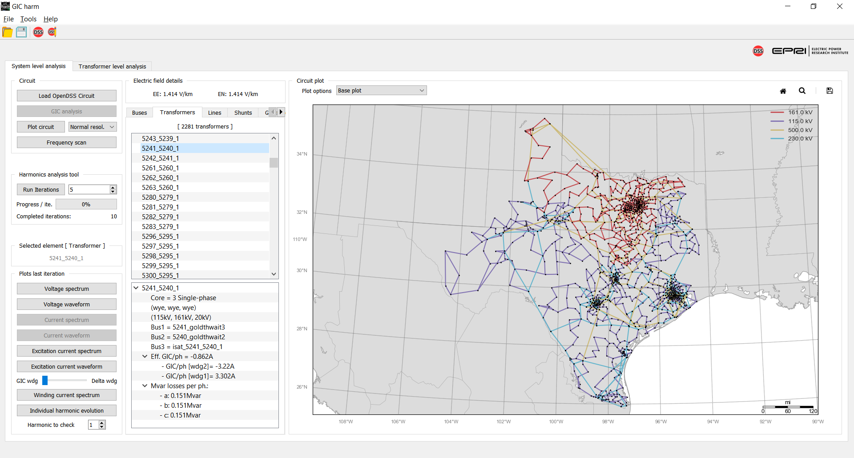
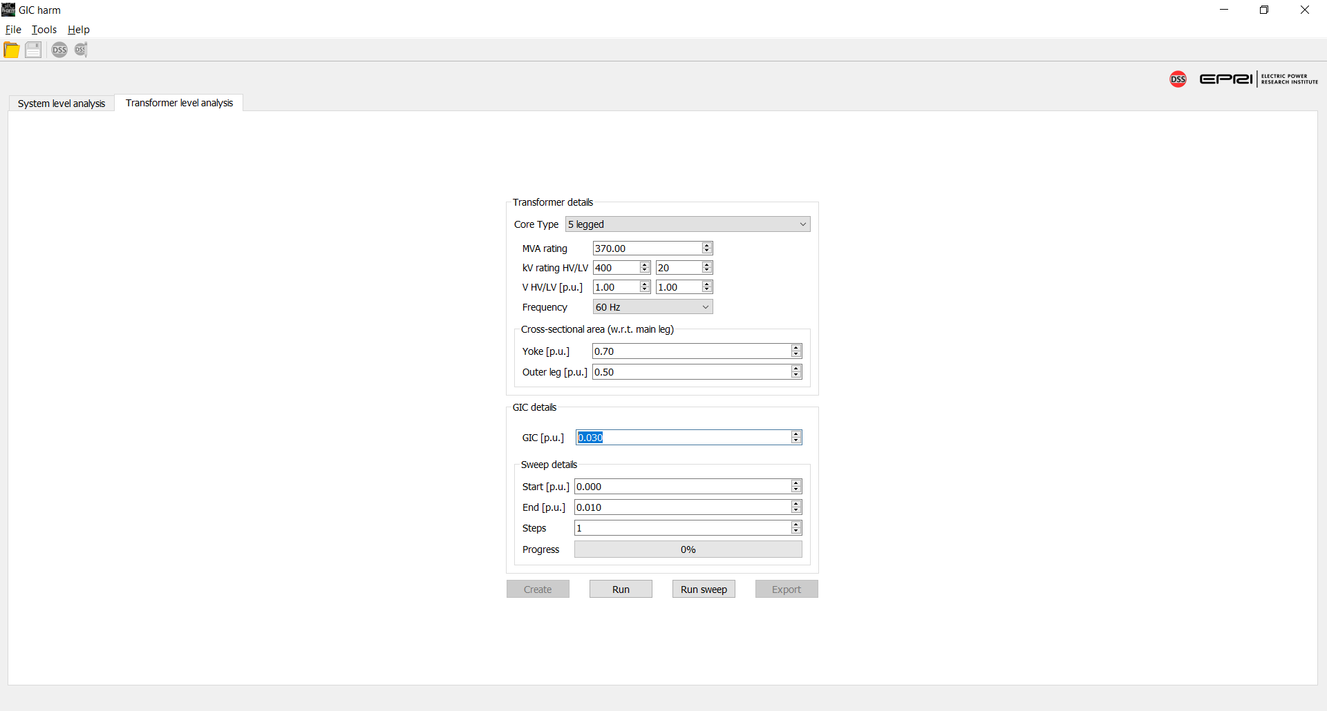
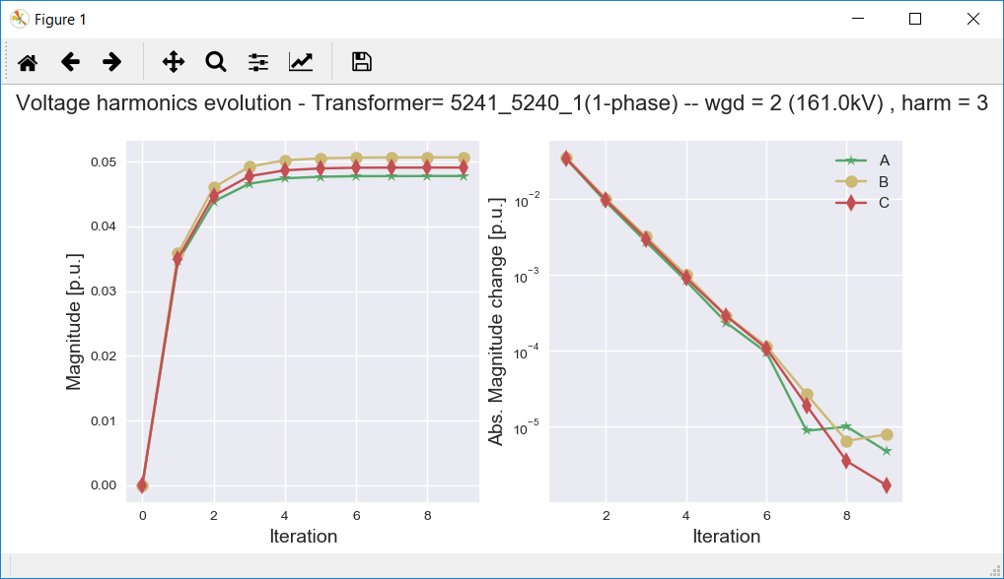
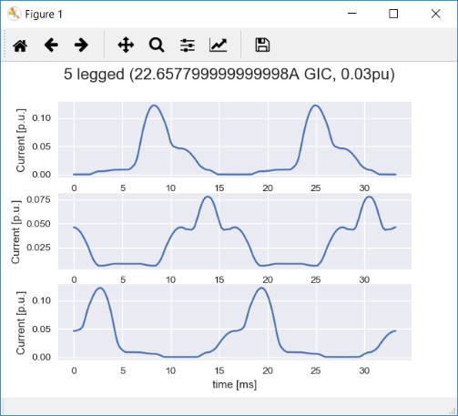
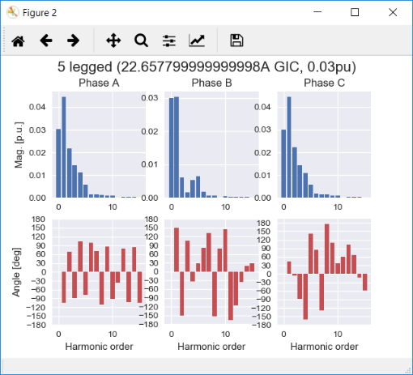
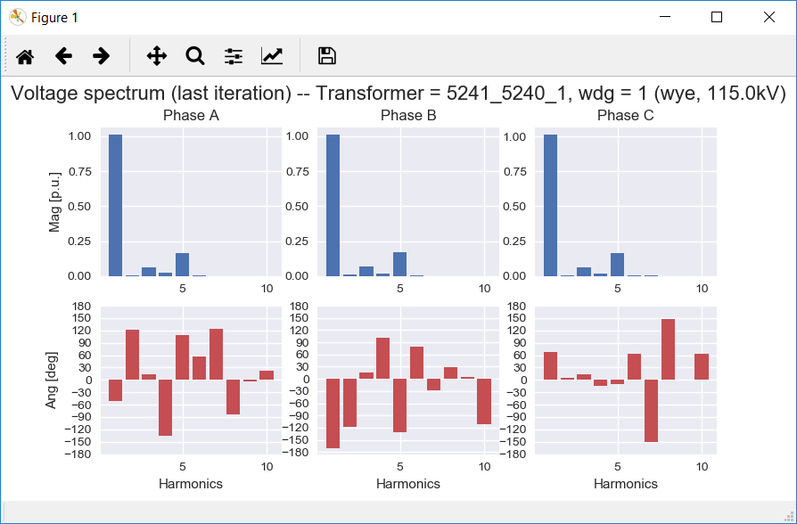
GICharm Capabilities
Transformer level analysis
System level Analysis
PSS®E to GICharm / OpenDSS converter
Notes:
GICharm has 3 main components, a System Level Analysis, a Transformer Level Analysis and a PSS/E to OpenDSS converter.
I’m going to briefly describe these and the routines that take place behind the scenes.

Slide 12
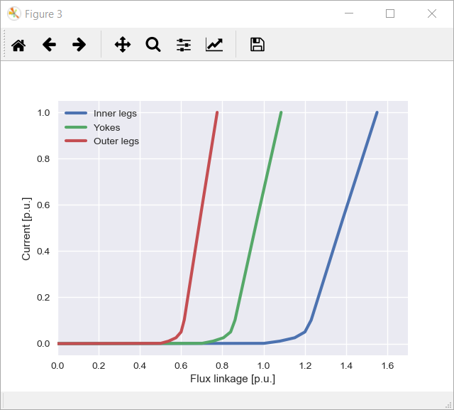
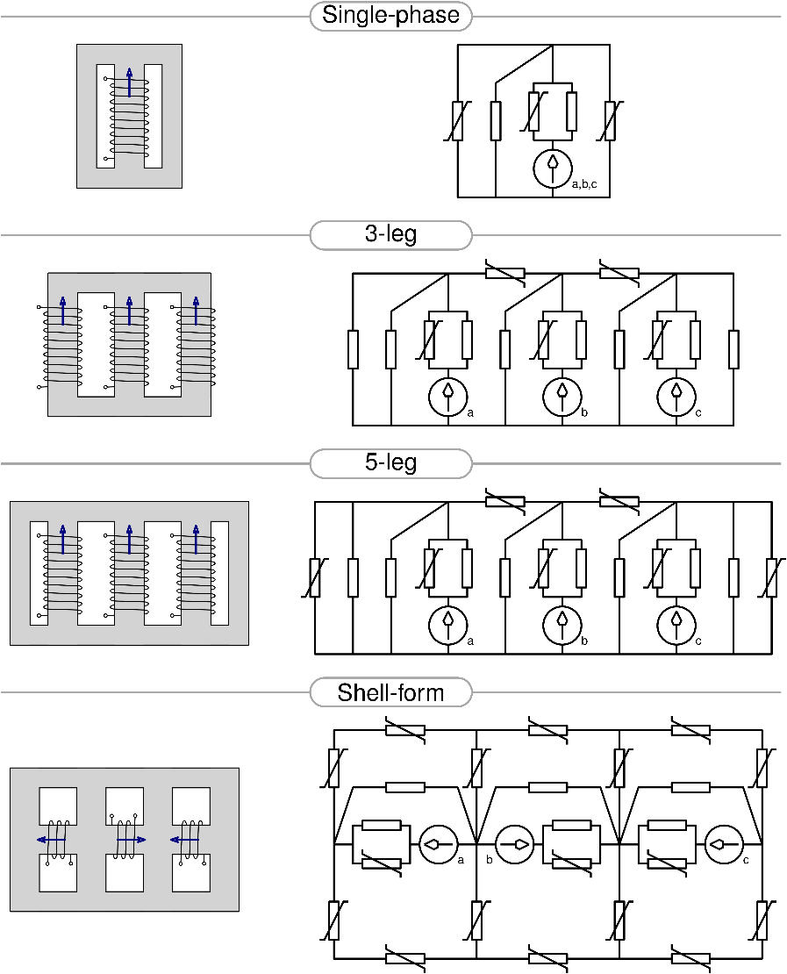
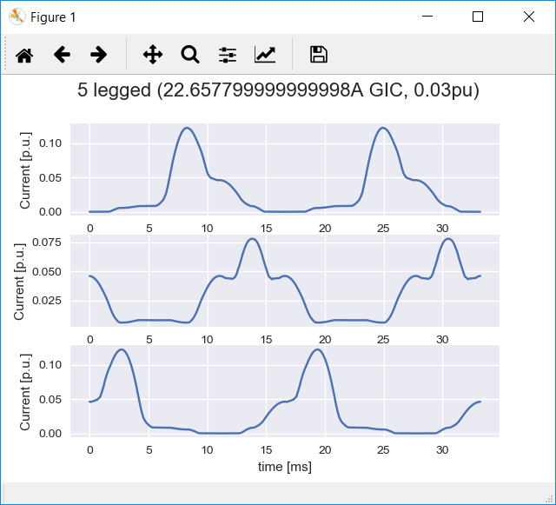

Transformer Level Analysis
Non-linear saturation analysis
Time domain analysis
Magnetic circuit modeling
Notes:
The Transformer level analysis tool was developed for the analysis of a single transformer with one of the core topologies that we can see in this slide.
- Bank of three single phase shell-forms, 3-legged core-form, 5-legged core-form and shell-form.
Last year’s release included a 4-legged core form and a bank of three single-phase core-form transformers.
The transformer level analysis utilizes the user-defined parameters of the transformer to create a magnetic circuit that represents the core topology accordingly. Then, it solves the circuit for the excitation currents given an effective GIC input.

Slide 13
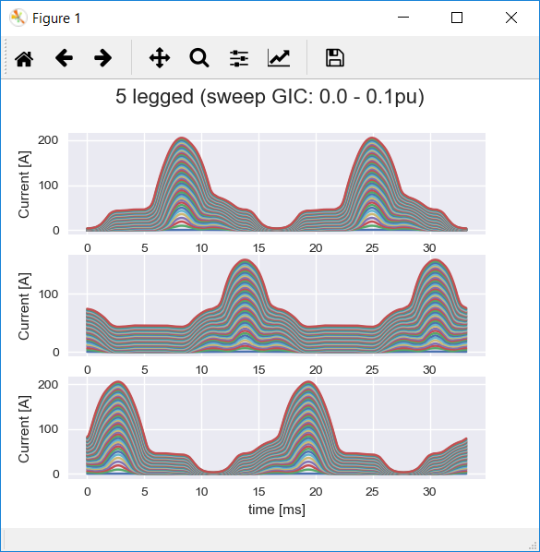
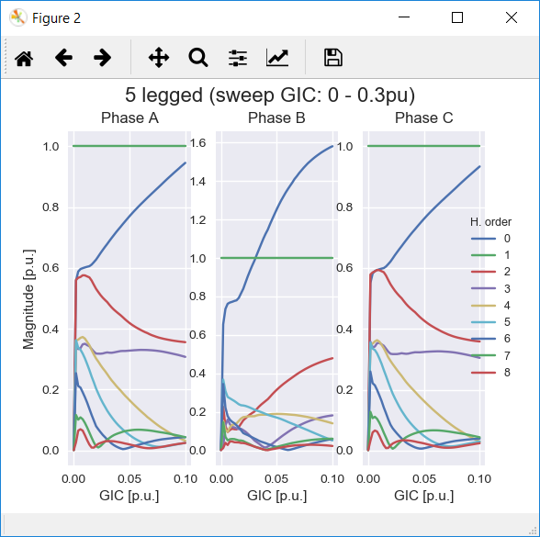
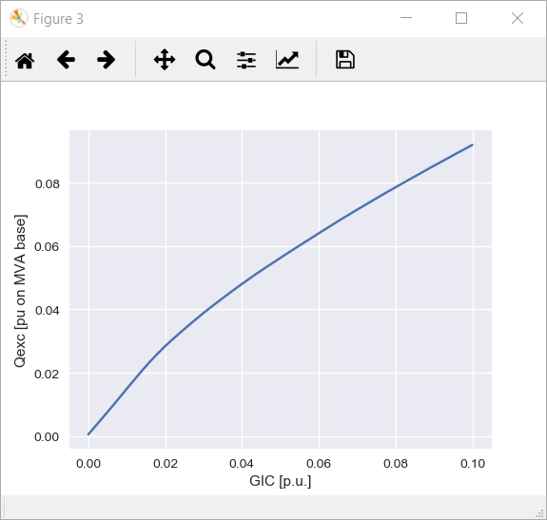
Transformer Level Analysis
Non-linear saturation analysis
Time domain analysis
Magnetic circuit modeling
Notes:
Another option of the Transformer Level Analysis consists of running GIC sweeps across a user-defined range of GIC inputs in order to determine the reactive power losses curve per GIC as seen in the bottom right corner of this slide.

Slide 14
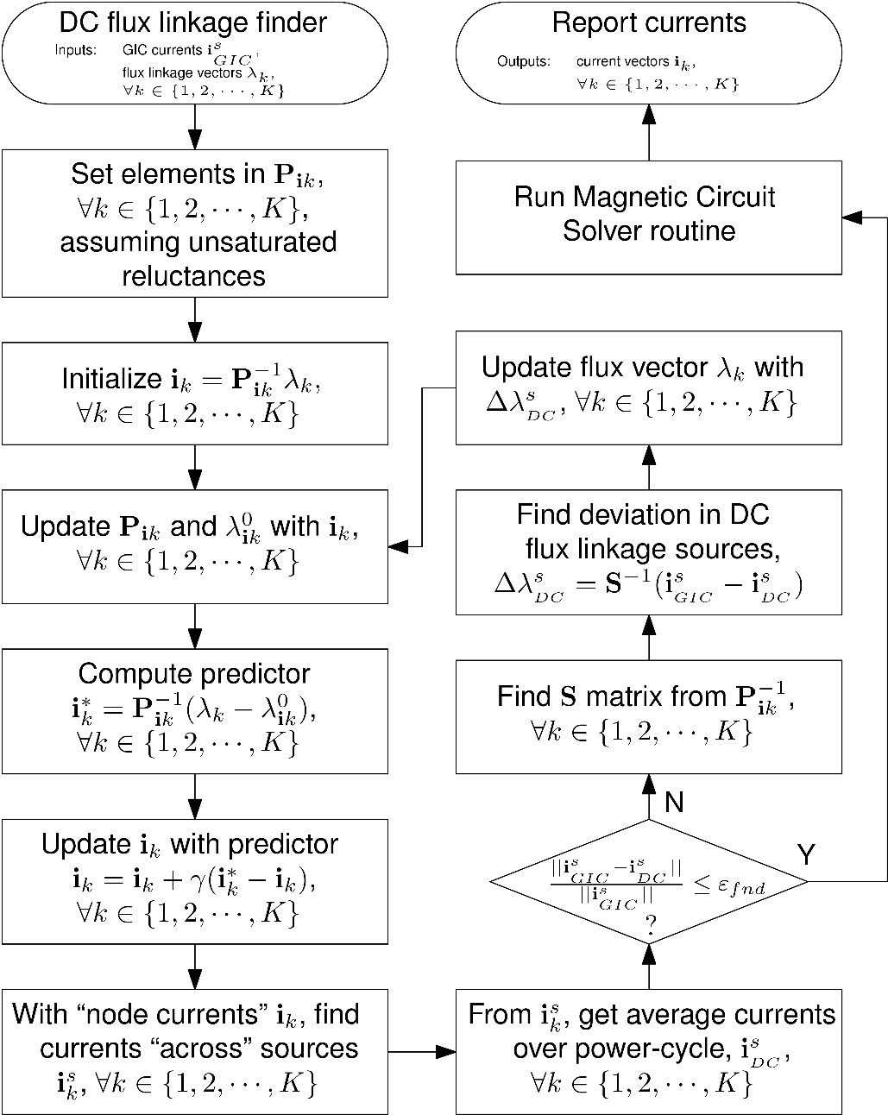
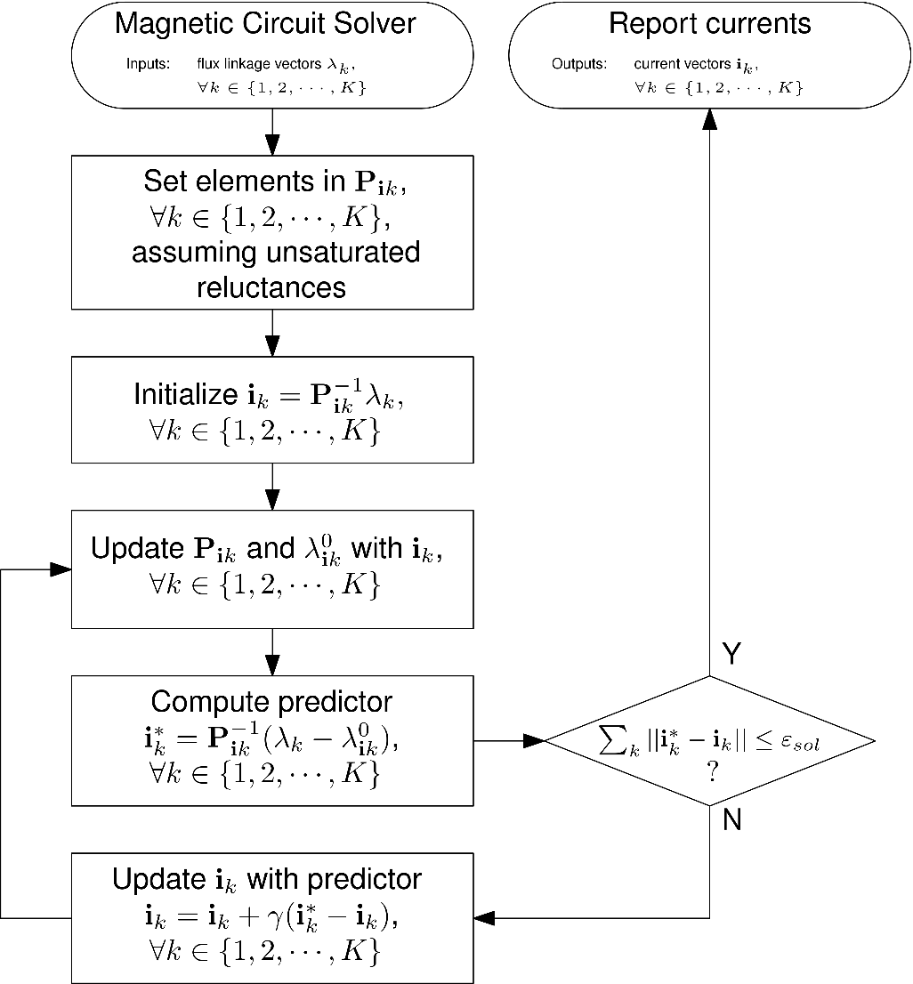
Transformer Level Analysis
Networks of nonlinear monotone reluctances
Solves for the excitation currents per time step in a power cycle
Finds flux offset over the power cycle for a given GIC input
Notes:
As I mentioned earlier, GICharm creates a magnetic circuit with the user-defined transformer parameters. This magnetic circuit is a network of linear reluctances and piece-wise linear saturable reluctances with multiple flux source inputs.
If we carefully make an analogy to electric circuits, this magnetic circuits fall into the category of “Networks of nonlinear monotone resistors” which have a unique solution for each unique combination of inputs.
The internal magnetic circuit solver and DC-flux finder algorithms take advantage of this property to compute the excitation current waveforms for each time step in a power cycle. They replicate the magnetic circuit for each time step in the power cycle and solve each time step for the magneto-motif forces across each flux source.

Slide 15
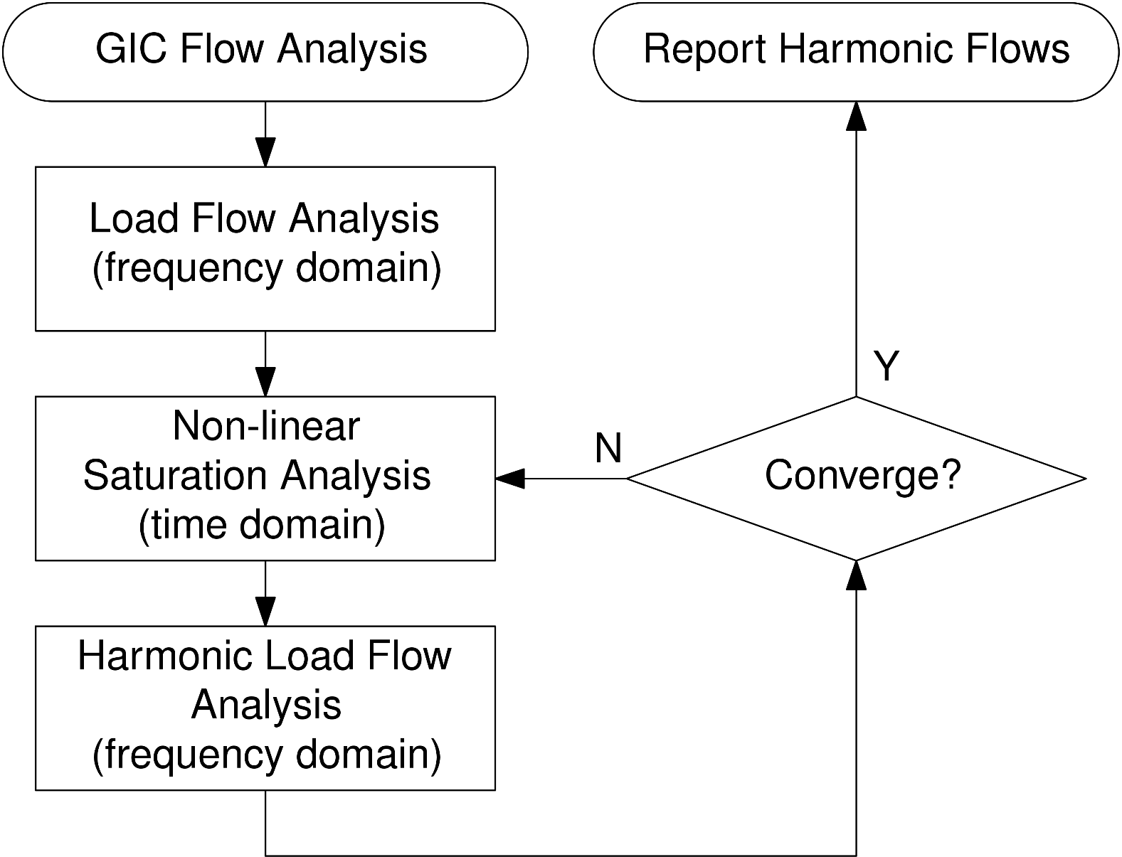
System Level Analysis
Pre-event system state is determined by a load flow. Can be determined by an external source (PSS®E)
GIC flows are determined from geo-electric field parameters
Notes:
On the other hand , the System Level Analysis tool is intended to assess the entire system footprint under a GMD event.
It takes the pre-event load flow conditions from the PSS/E input files. It can also import the GIC flows from that external source, or it can run an internal GIC flow study to determine the effective GICs for each transformer in the system.

Slide 16
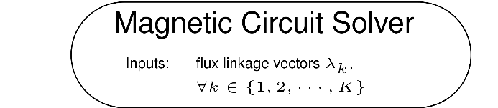
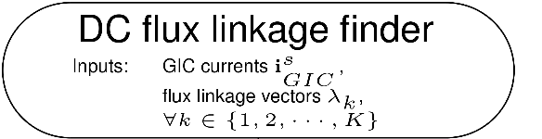
System Level Analysis
Pre-event system state is determined by a load flow. Can be determined by an external source (PSS®E)
GIC flows are determined from geo-electric field parameters
Transformer level analysis performed for each transformer in the fleet
Notes:
With the initial load flow and gic flow conditions, the tool runs a transformer level assessment for each transformer in the fleet to determine the harmonic content of the excitation currents.

Slide 17

System Level Analysis
Pre-event system state is determined by a load flow. Can be determined by an external source (PSS®E)
GIC flows are determined from geo-electric field parameters
Transformer level analysis performed for each transformer in the fleet
Harmonic load flow to determine voltage harmonic distortion throughout the system
Notes:
Then, it runs a harmonic load flow analysis to determine the harmonic content of voltages across the entire system and specially across the windings of the transformers. This in turn will affect the harmonic content of the flux waveforms and therefore the excitation currents too.

Slide 18
System Level Analysis
Pre-event system state is determined by a load flow. Can be determined by an external source (PSS®E)
GIC flows are determined from geo-electric field parameters
Transformer level analysis performed for each transformer in the fleet
Harmonic load flow to determine voltage harmonic distortion throughout the system
Repeat until convergence criteria is reached
Notes:
The convergence criteria is defined based on the evolution of the harmonic content of voltages over the iterations of this loop.
If a convergence has not been reached, then the process of finding the harmonic content of the excitation currents is repeated for the new harmonic content of voltage and the process is repeated until convergence is reached.

Slide 19
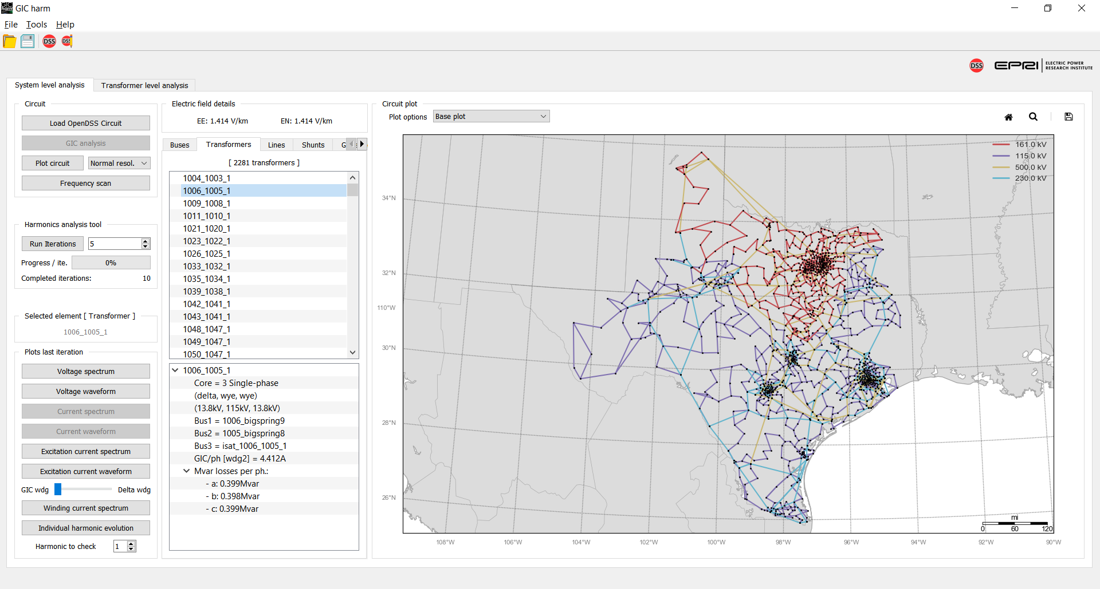
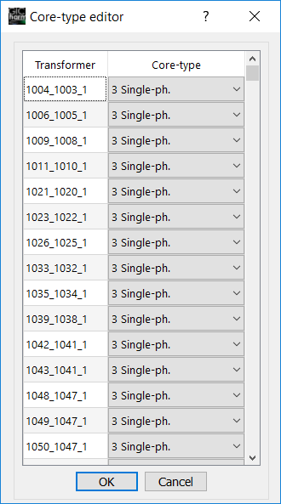
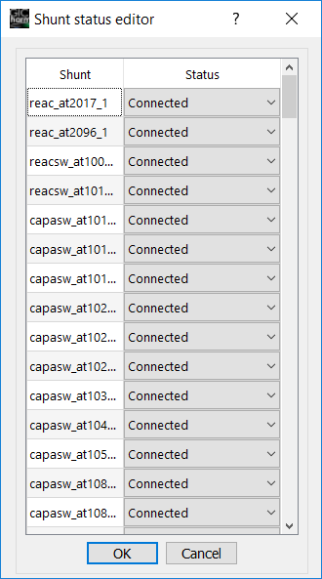
System Level Analysis – Explore System Details
Tool allows to explore relevant elements:
Buses
Transformers
Lines
Shunts
Generators
Allows the user to consider different scenarios by changing:
Transformer core topologies
Geo-electric field components
Connect / disconnect Capacitor banks
Notes:
These are a couple of screen grabs taken from the tool and some highlights about the current capabilities.
It allows the user to explore relevant elements and change some of their relevant parameters like the core topology of transformers.

Slide 20
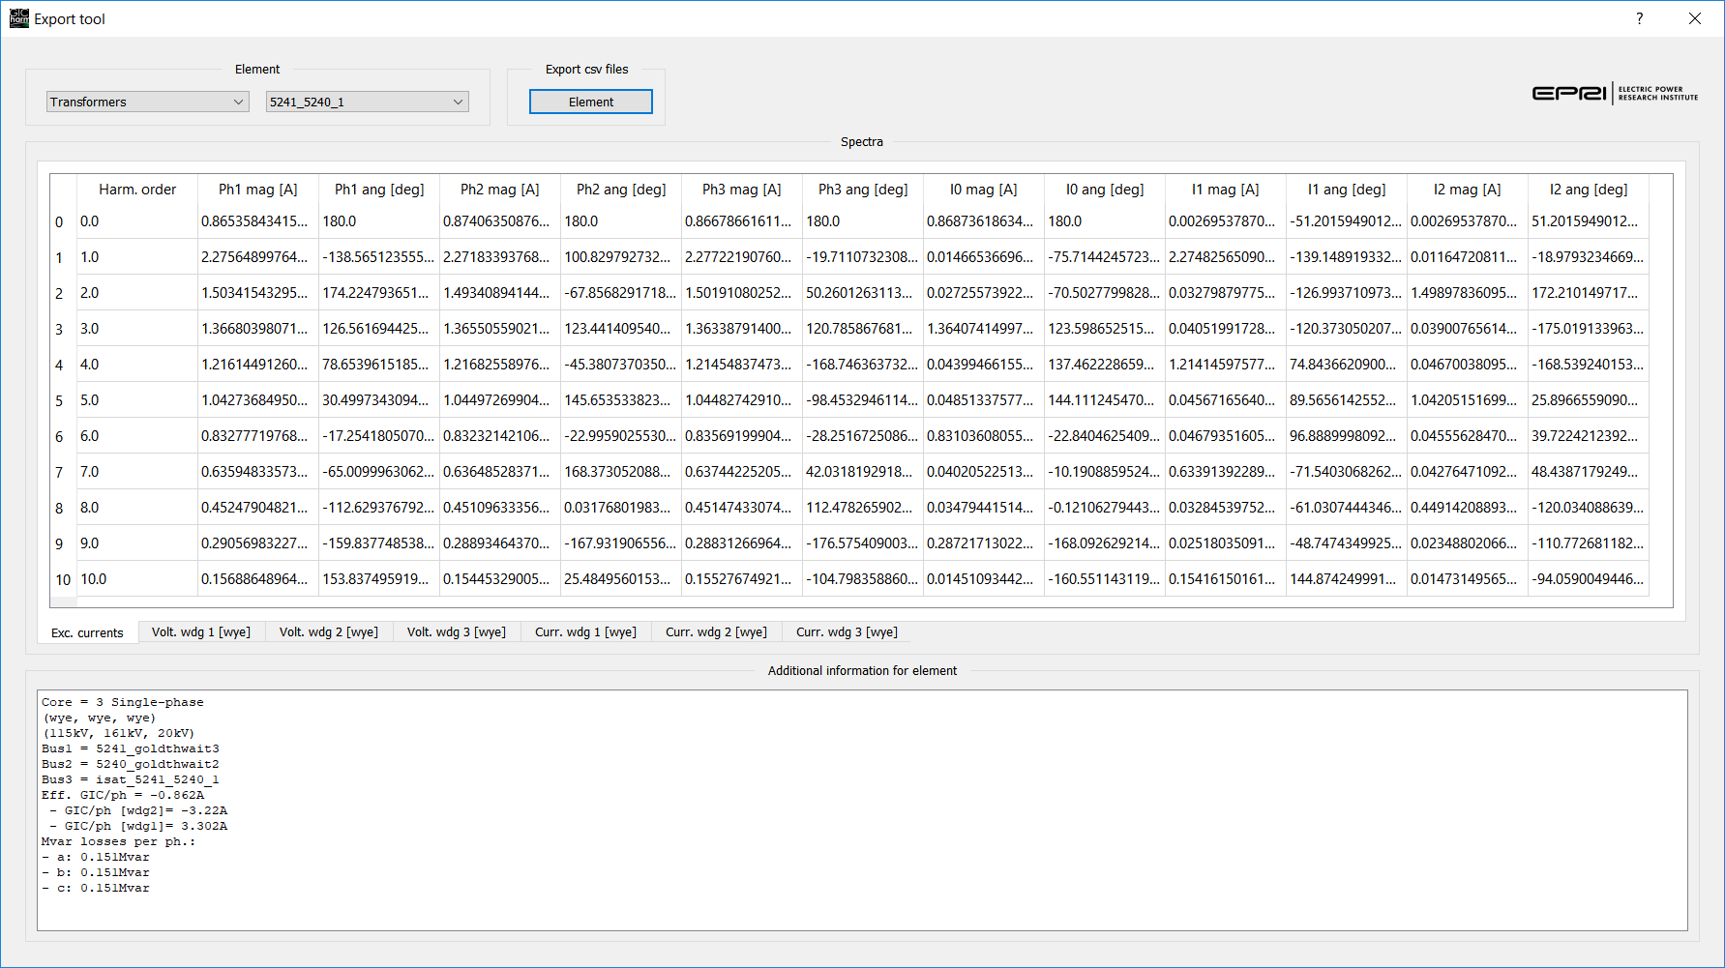
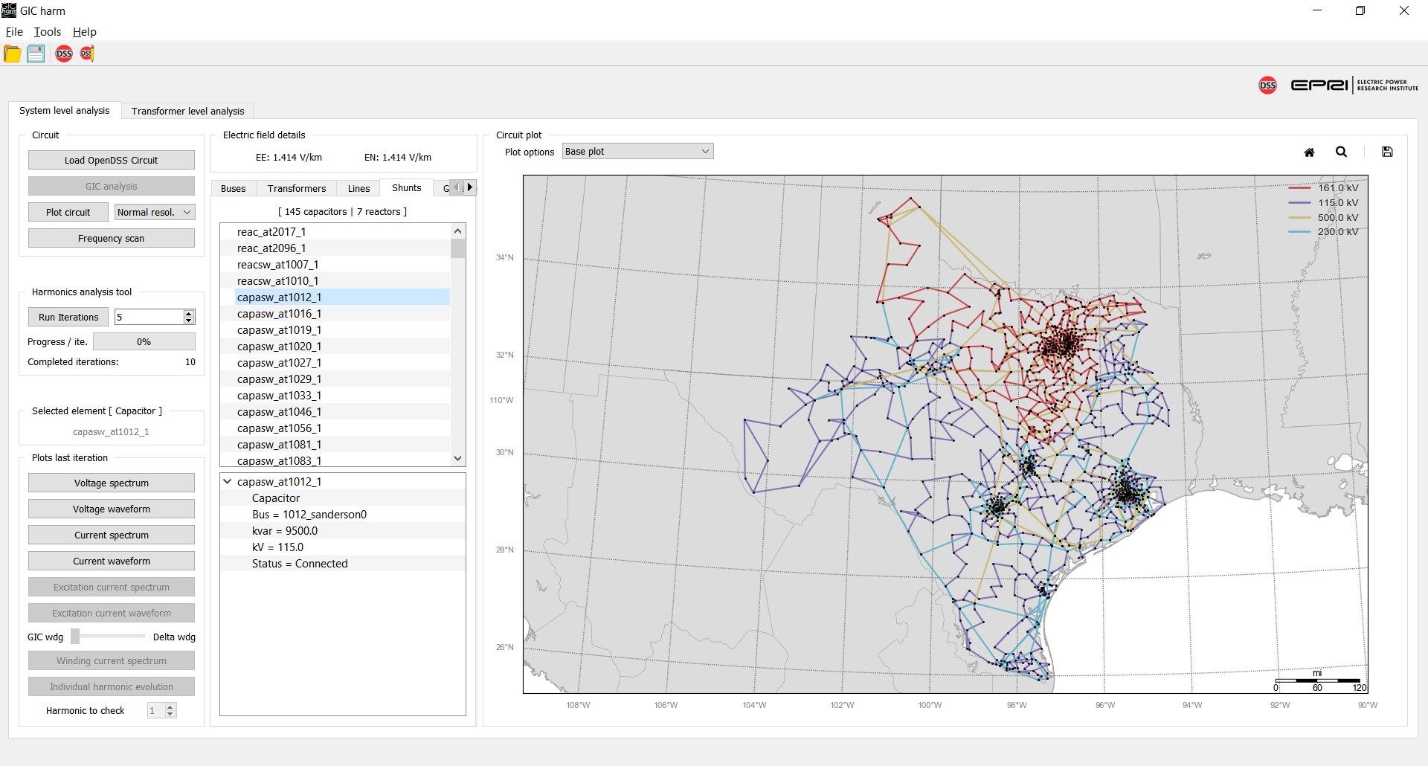
System Level Analysis – Explore Simulation Results
Explore simulation results with waveforms and spectra of voltage and current for:
Transformer windings
Capacitors and reactors
Generators
For transformers
Evolution of the harmonic content of voltage through the iterations of the harmonic loop
Export results to csv files: The tool includes a built-in tool to export user-selected results.
Notes:
…Users can also explore and export the harmonic content of voltages and currents for devices across the system and use some of the visualization capabilities that are built-in in the tool.
…

Slide 21
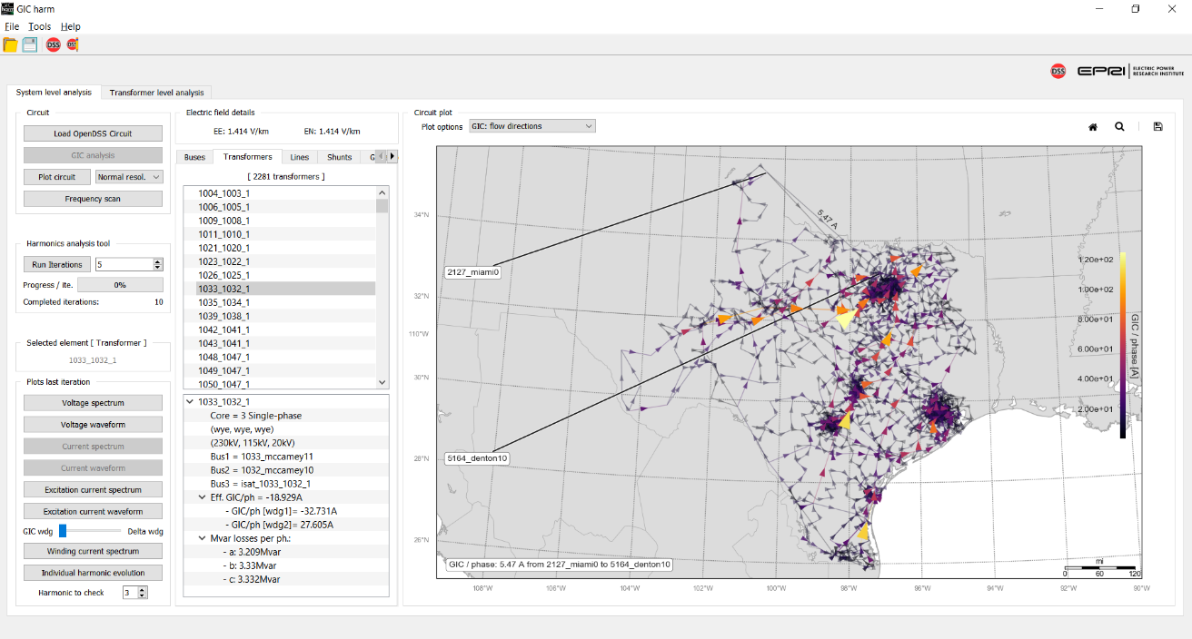
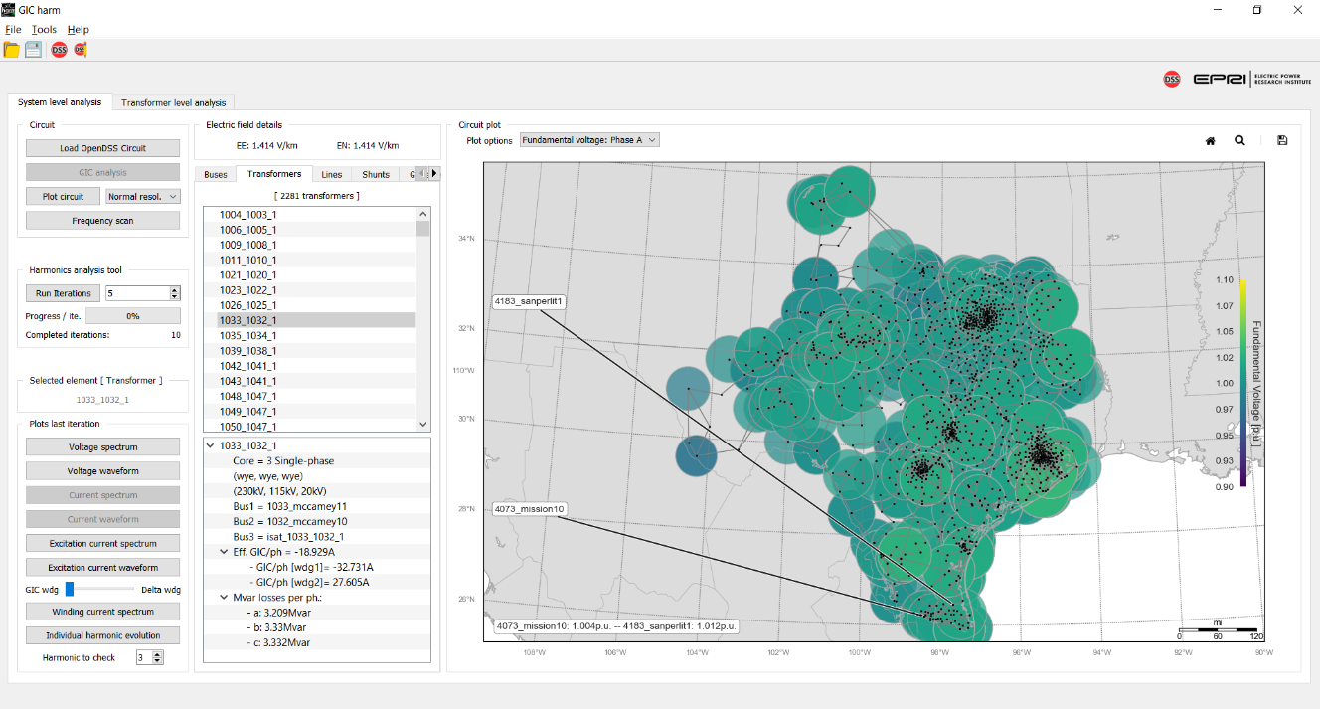
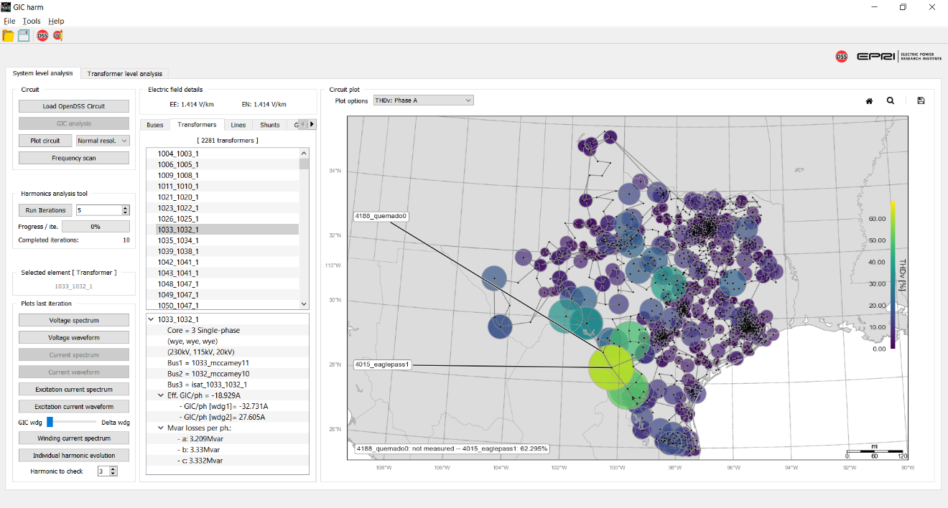
System Level Analysis – Explore Simulation Results
GUI includes circuit plot capabilities to overlay GIC flows, voltage THD and fundamental voltage data over the circuit footprint
Notes:
…Or visualize relevant information like the voltage total harmonic distortion or GIC flows over the system footprint.

Slide 22
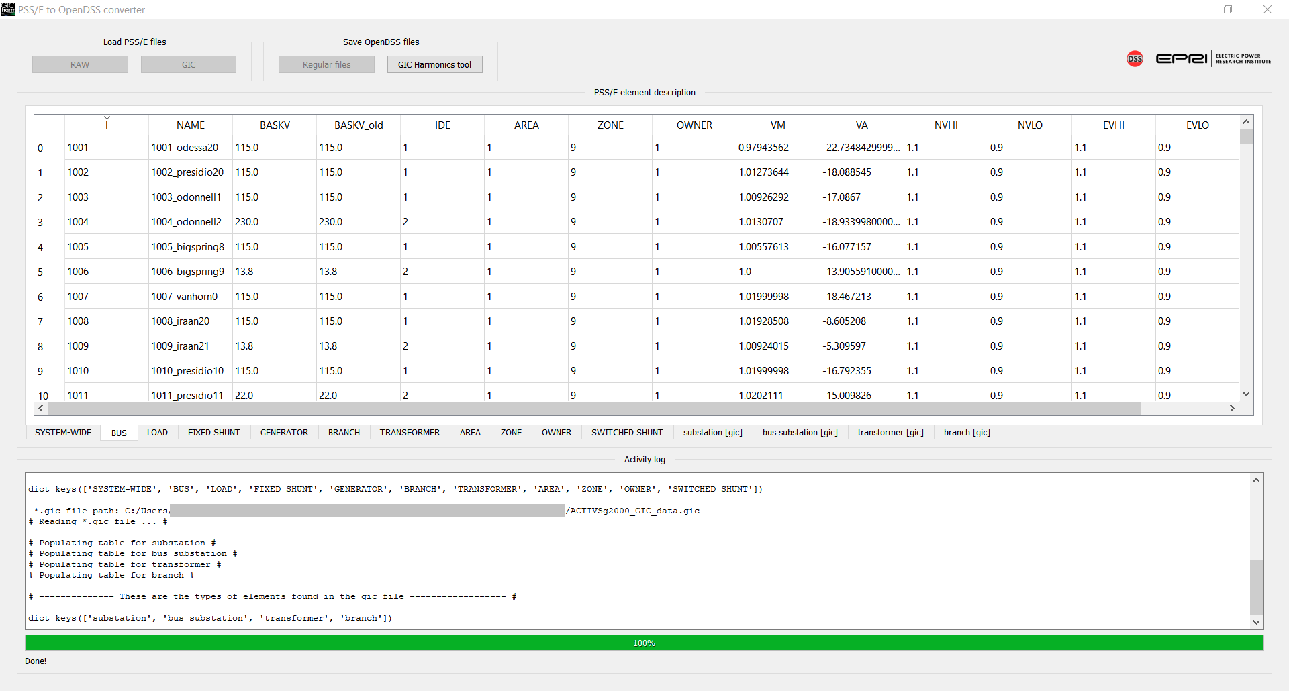
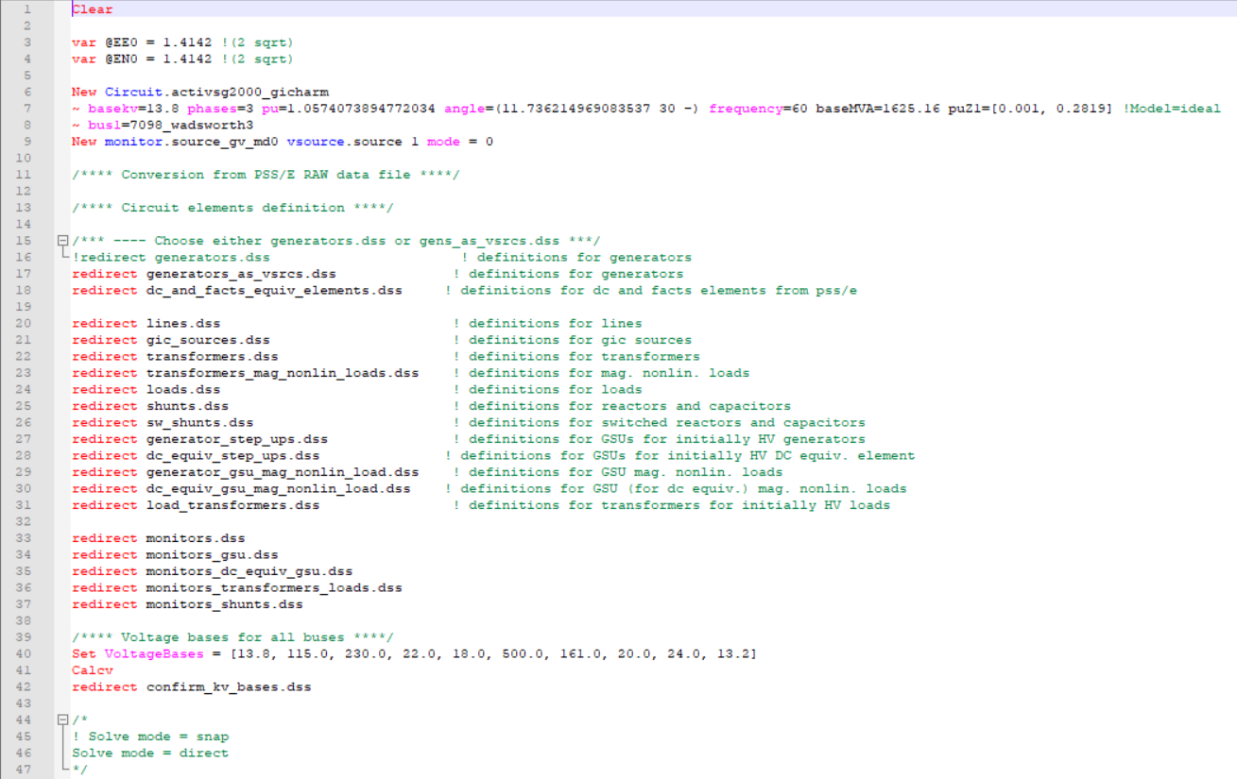
PSS®E to OpenDSS Converter
Data imported from PSS®E *.raw and *.gic files
Data cleaning after import
Data conversion to regular and GICharm *.dss files
Notes:
The last piece of GICharm is the built-in PSSE to OpenDSS converter. It takes PSS/E’s RAW and GIC files and creates a model in OpenDSS format that GICharm can use.
This year’s release will also assimilate PSSE’s SEQ file which contains zero sequence and mutual coupling information. If that file is not available, the converter will still make assumptions based on the voltage level and the positive sequence values to create the DSS model.

Slide 23
Validation Case and Other Cases to Explore

Slide 24
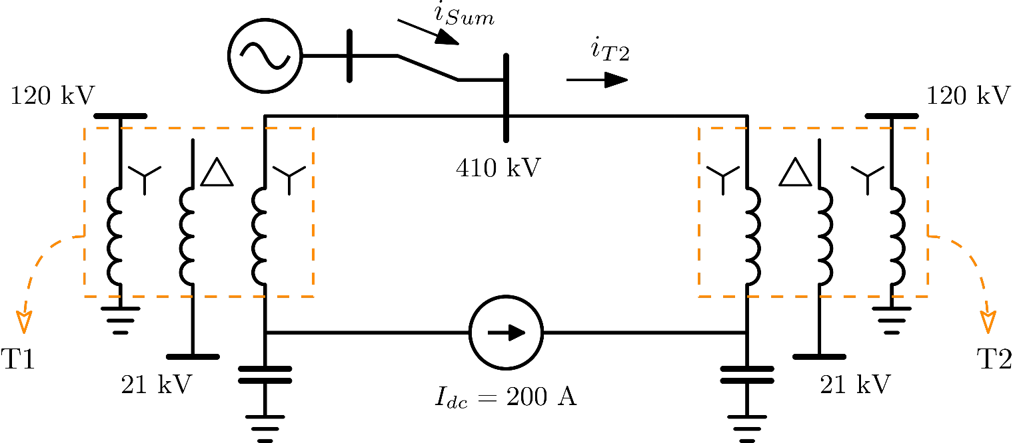
Validation Case: FinGrid Experiment
Experiment with two 5-limb core-form transformers connected back-to-back forming a loop
Neutrals of HV Wye windings connected by a DC current source to simulate a GIC event
DC source set to 200 A or 66.67A per phase
HV windings grounded by 150 uF capacitors to keep the DC currents in the loop
[4] M. Lahtinen, and J. Elovaara, “GIC Occurrences and GIC Test for 400 kV System Transformer,” IEEE Trans. Power Del., vol. 17, no. 2, pp. 555-561, 2002.
Notes:
As part of the development of GICharm, the experiment described in this slide was identified as a validation objective.
This experiment was carried out in a location of the Finish Power System and the results were originally published in the IEEE paper referenced at the bottom of the slide.
It consists of two 5-limb core-type 3 winding transformers with their high voltage wye windings connected back-to-back. The neutrals were linked through a DC current source and each of them was grounded using a capacitor keeping a DC current loop. The DC source was set to 200 amps to emulate a GIC of 66.67 amps per phase plus and minus on each transformer.
Additional details about this experiment can be found in the two references at the bottom of the slide. These were used to define the parameter of the GICharm model.
The details of the model can be found in the paper and the model itself is included as an example with the tool.

Slide 25
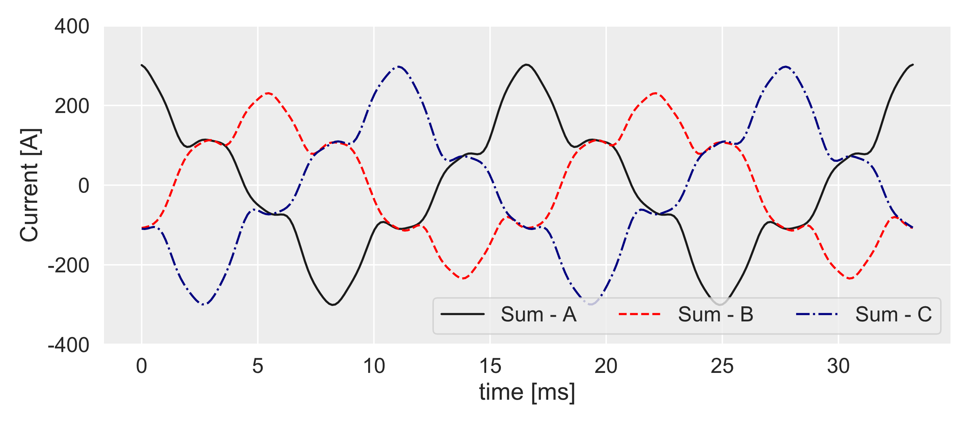
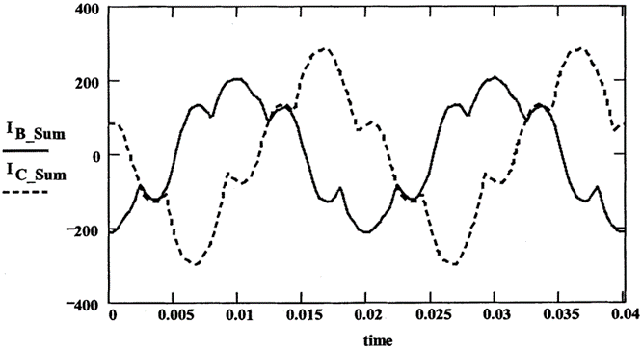
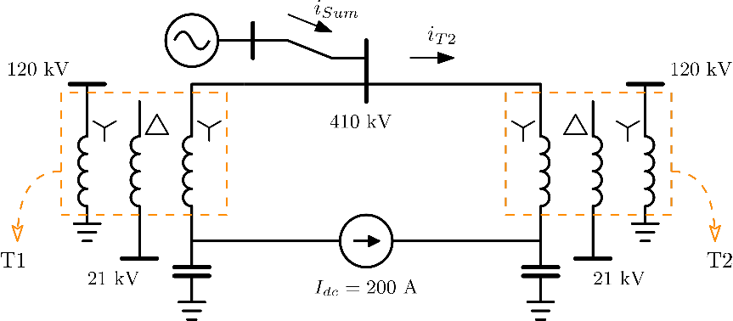
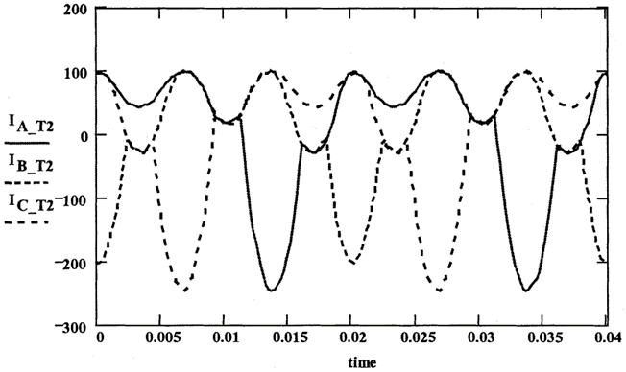
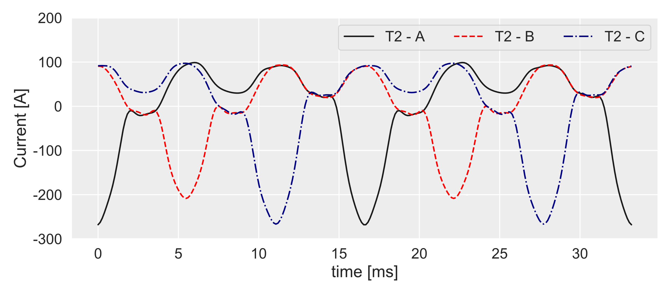
Experimental results Used with permission from IEEE [4]
Simulation Results GICharm
[4] M. Lahtinen, and J. Elovaara, “GIC Occurrences and GIC Test for 400 kV System Transformer,” IEEE Trans. Power Del., vol. 17, no. 2, pp. 555-561, 2002.
Notes:
Here on the left we have some of the original experimental results that can be found in the reference at the bottom of the slide. On the right-hand side, we can see the simulation results obtained with GICharm.
The top two figures show the negative of the current waveforms per phase flowing from the transformer arrangement to the grid. The two figures at the bottom show the current waveforms for the three phases flowing into one of the transformers.
Some of the parameters in the GICharm model were assumed due to lack of information available. However, the simulation results were satisfactory and close to those of the initially reported experiment.
The main highlight that can be taken from this validation is the speed at which these results can be obtained using GICharm. For comparison, an EMT model may require long computational time to simulate this model until it reaches a steady state. In turn, the GICharm model converges in a couple of iterations of the system level tool for this case. The comparison takes relevance when complex models with several transformers are considered.

Slide 26
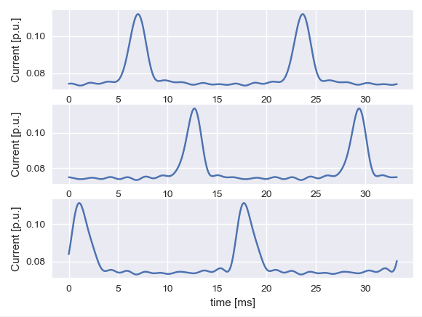
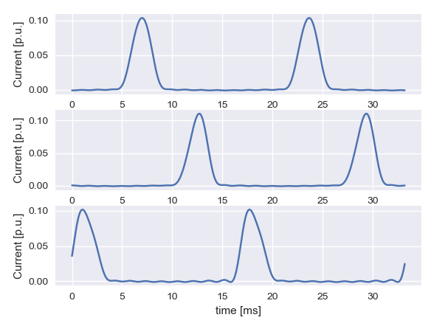
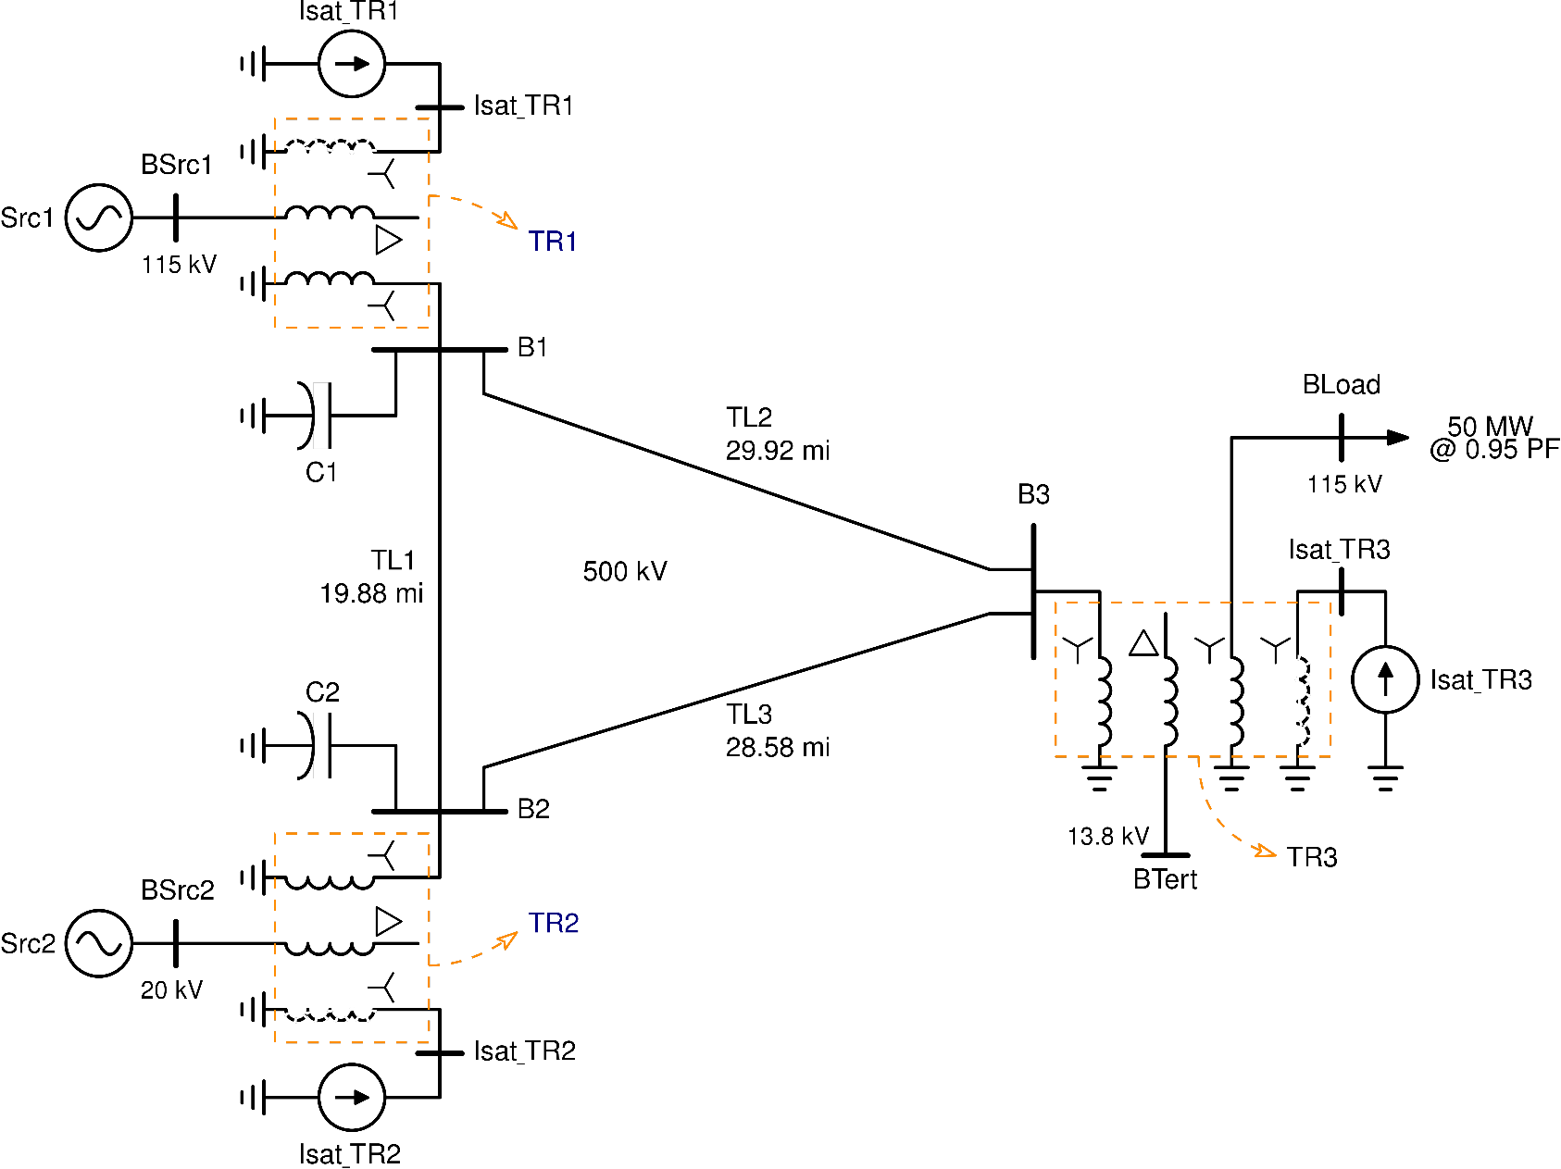
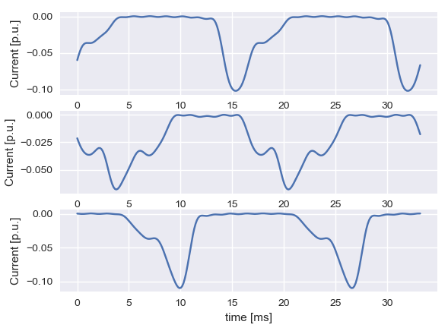
3-Bus Benchmark Case
27.8 Mvar
TR1: 22.6 A
TR2: 12.9 A
Transformer excitation currents
0.9 Mvar
TR2: -35.5 A
A: 11.7 Mvar B: 9.7 Mvar C: 12.0 Mvar
33.4 Mvar
[4] A. Ovalle, R. Dugan, and B. Arritt, “A Test Case for GIC Harmonics Analysis,” in CIGRE US National Committee 2019 Grid of the Future Symposium, 2019.
Notes:
Some other test cases are included in the folder of examples provided with the tool. One of those cases is the model in this slide. It is a benchmark test case that was recently published in the reference at the bottom. We encourage viewers to download the tool and run some simulations or test their own models and we welcome any feedback that ay help us improve the tool.

Slide 27
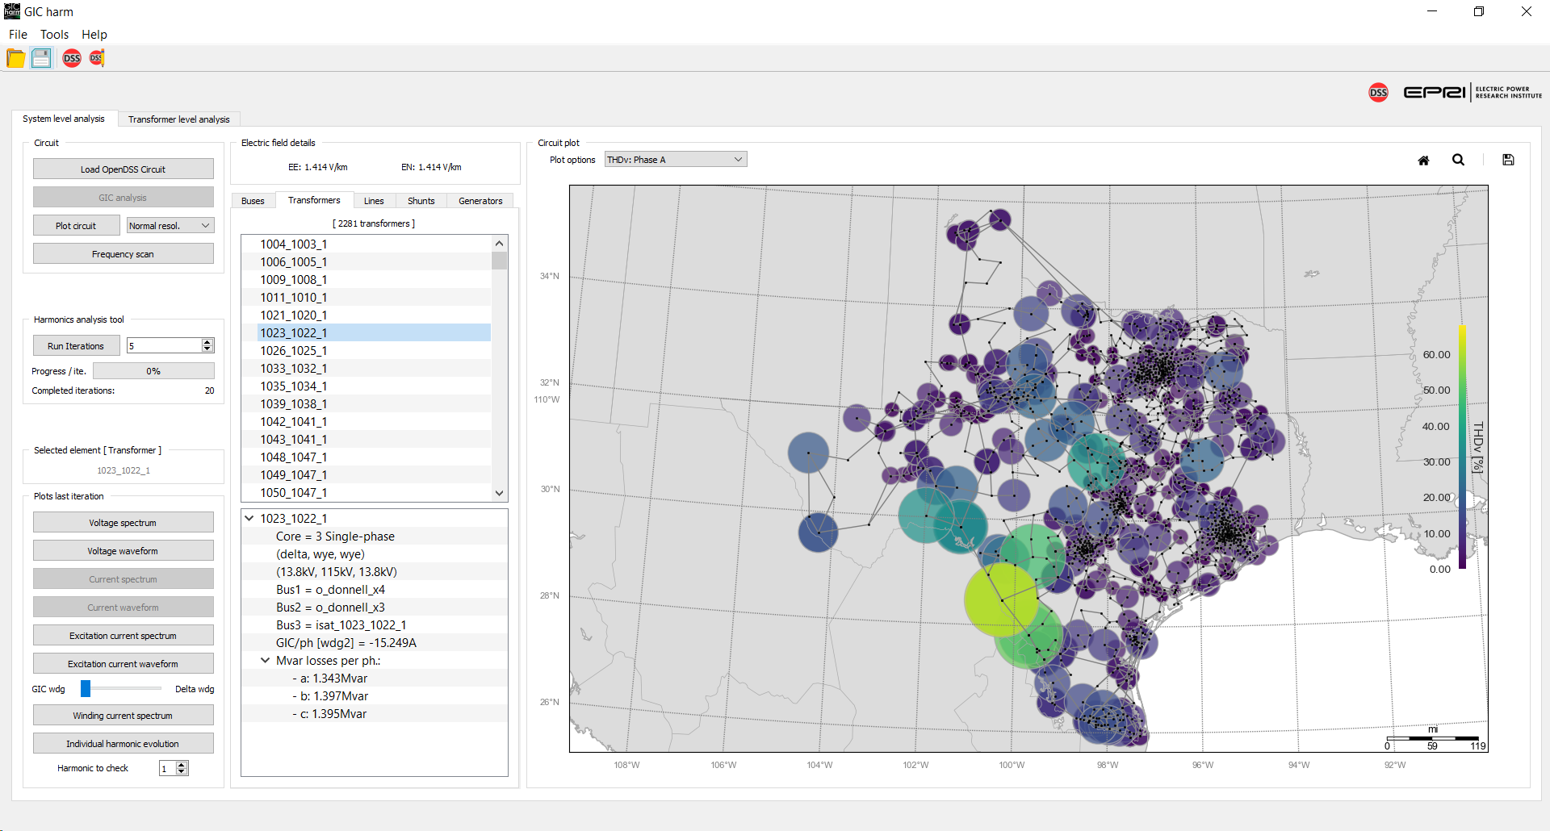
Other Test Cases to Explore
ERCOT synthetic case from Texas A&M University - Electric Grid Test Case Repository.
2k buses
861 Transformers
2,281 Transformers including added load transformers and GSUs
[5] A. B. Birchfield, T. Xu, and T. J. Overbye, “Power flow convergence and reactive power planning in the creation of large synthetic grids,” in IEEE Transactions on Power Systems, 2018.
Notes:
This is another case included as an example of GICharm. It was converted to GICharm OpenDSS format from one of the synthetic cases available in the electric test grid repository of the Texas A&M university.

Slide 28
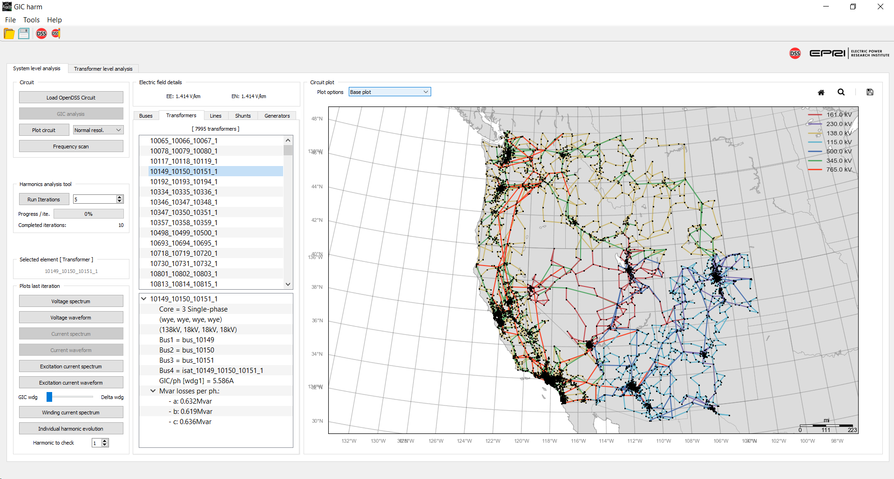
Other Test Cases to Explore
Western Interconnect synthetic case from Texas A&M University - Electric Grid Test Case Repository
10k buses
2,380 Transformers
7,995 Transformers including added load transformers and GSUs
[5] A. B. Birchfield, T. Xu, and T. J. Overbye, “Power flow convergence and reactive power planning in the creation of large synthetic grids,” in IEEE Transactions on Power Systems, 2018.
Notes:
And finally, this is another case that was converted from one of the synthetic cases available in the electric test grid repository of the Texas A&M university. This cases were used to test the limits of the tool in terms of transformers and complexity of the system under test.

Slide 29
Thank you! Questions?

